Slide 1


Amberlie
25 July 2024

Slide 2

Outline
Executive Summary
Introduction
Methodology
Results
Conclusions

Slide 3
Executive Summary
Summary of methodologies
Data collections (using Web scraping)
Data wrangling
Exploratory Data analysis with Data Visualization
Exploratory Data analysis with SQL
Building Folium interactive maps
Building an Interactive Dashboard with Plotly Dash
Machine Learning – Predictive analysis (using classfification)
Summary of all results
Exploratory Data analysis results
Interactive analytics
Predictive analysis results

Slide 4
Introduction
Project background and context
SpaceX is one of the most successful companies for affordable space travel. SpaceX advertises the Falcon9 rocket launches as 62 million dollars, whereas other providers cost upwards of 165 million dollars each. The reason for this price difference is that the first stage of launching can be reused. Therefore, if we determine whether the first stage will land, we can determine the cost of the launch. The goal of this project is to use the public information and training a machine learning model to predict if SpaceX will land successfully and reuse the first stage.
Problems you want to find answers
How do variables such as launch site (and nearby facilities), orbits, and payload mass affect the success of the first stage landing?
Has the success rate changed over the years?
What is the best algorithm in predictive analysis?

Slide 5

Section 1

Slide 6
Methodology
Executive Summary
Data collection methodology:
Web scraping from Wikipedia and API SpaceX Data collection
Perform data wrangling
One-hot encoding, filtering data, removing missing values
Perform exploratory data analysis (EDA) using visualization and SQL
Perform interactive visual analytics using Folium and Plotly Dash
Perform predictive analysis using classification models
How to build, tune, evaluate classification models

Slide 7
Data Collection
To collect the data from the API, a get request was performed
The response is called as a json using .json()
Converted into a Pandas data frame after normalizing using data=pd.json_normalize()
Web scraping of Wikipedia using BeautifulSoup was also performed
Data from those tables was parsed and converted into a Pandas df
Dataframe was filtered to only include Falcon 9 launches
The data cleaned and missing values filled in e.g. payload mass used the calculated .mean()
Notes:
Add github link

Slide 8
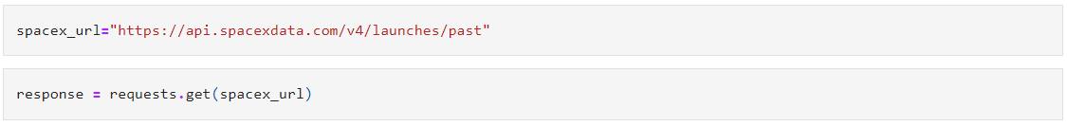
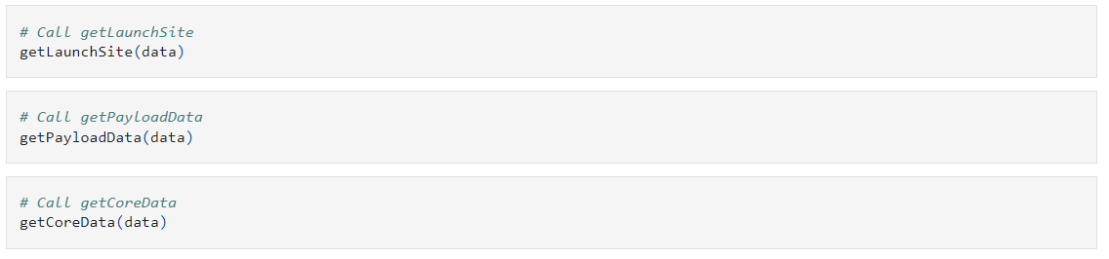
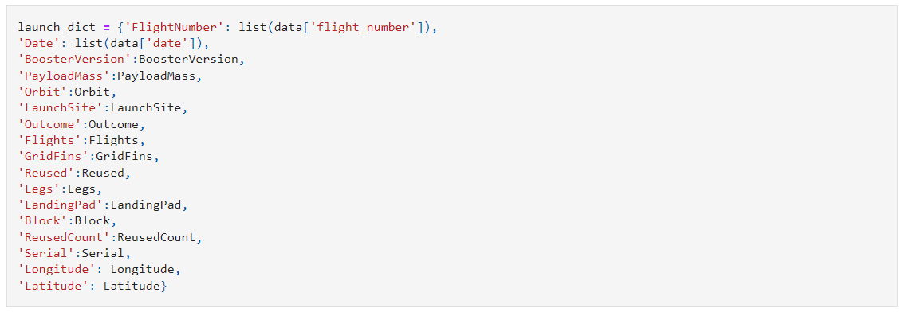
Data Collection – SpaceX API
Request rocket launch data from API
Decode the response and turn into a data frame using .json_normalize()
Request info by applying custom functions
Construct data into a dictionary and create a data frame from it
Filter the data for Falcon 9
Replace missing values with the column mean
Export the data to CSV
GitHub: jupyter-labs-spacex-data-collection-api (1).ipynb

Slide 9
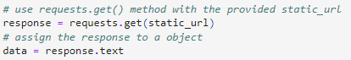
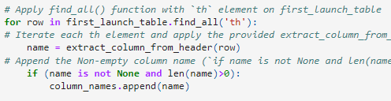
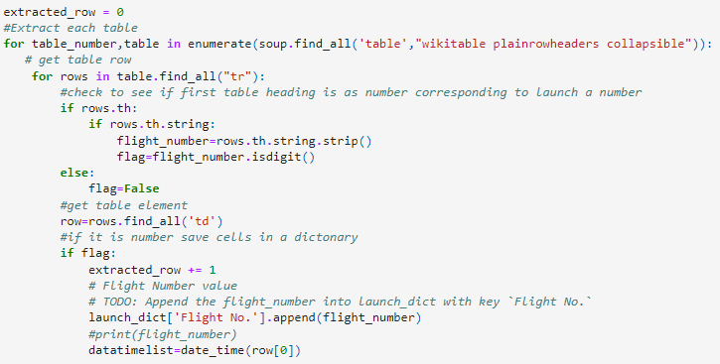
Data Collection - Scraping
Request Falcon 9 data from the static url
Create a BeautifulSoup object from the HTML response
Extract all the column names from HTML table
Parse the tables to collect data
Convert data into dictionary and create data frame
Export to CSV
GitHub: jupyter-labs-webscraping.ipynb

Slide 10
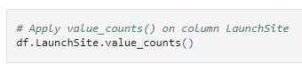
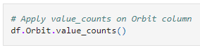
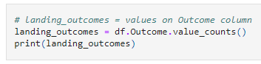
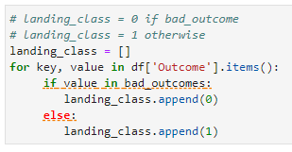
Data Wrangling
Perform EDA to determine data labels
Calculate:
Number of launches for each site
Number and occurrence of orbit
Number and occurrence of mission outcome per orbit type
Create binary label outcome and export to CSV
Landing outcome:
True Ocean: mission outcome was successfully landed to a specific region of the ocean
False Ocean: mission outcome was unsuccessfully landed to a specific region of the ocean
True RTLS: mission outcome was successfully landed to a ground pad
False RTLS: mission outcome was unsuccessfully landed to a ground pad
True ASDS: mission outcome was successfully landed to a drone ship
False ASDS: mission outcome was unsuccessfully landed to a drone ship
Outcomes were categorised as a 1 for a successful landing and 0 for an unsuccessful landing
GitHub: labs-jupyter-spacex-Data wrangling.ipynb

Slide 11
EDA with Data Visualization
Charts
Flight Number vs Payload
Flight Number vs Launch Site
Payload Mass (Kg) vs Launch Site
Payload Mass (Kg) vs Orbit Type
Scatter plots were used to visualize the relationship between two variables and determine if there was one.
Bar charts were used to compare the discrete categories and determine the relationship among categories and a measured value.
GitHub: edadataviz%20(1).ipynb

Slide 12
EDA with SQL
SQL Queries:
Display the unique launch sites
Display 5 launch sites beginning with ‘CCA’
Display the total payload mass carried by boosters launched by NASA (CRS)
Display the average payload mass carried by boosters version F9 v1.1
List the date of the first successful landing on ground pad
List the names of the boosters which have success in drone ship and have payload mass greater than 4000 but less than 6000
List the total number of successful and failure mission outcomes
List the names of the booster_versions which have carried the maximum payload mass
List the records which will display the month names, failure landing outcomes in drone ship ,booster versions, and launch site for the months in year 2015
Rank the count of landing outcomes (such as Failure (drone ship) or Success (ground pad)) between the date 2010-06-04 and 2017-03-20, in descending order
GitHub: jupyter-labs-eda-sql-coursera_sqllite%20(2).ipynb

Slide 13
Build an Interactive Map with Folium
Markers of launch sites
Added a marker, circle, and pop-up label of NASA Johnson Space Centre using the latitude and longitude coordinates
Added a marker, circle, and pop-up label of all launch sites using their latitiude and longitude coordinates
Coloured markers of launch outcomes
Added green labels of success and red labels of failed launches using the Marker Cluster function to identify what launch sites have higher levels of success
Distances between a launch site to its proximities
Added coloured lines to show the distances between launch sites and its proximities, such as nearest railways, highways and cities
GitHub: lab_jupyter_launch_site_location.ipynb

Slide 14
Build a Dashboard with Plotly Dash
Dropdown list of launch sites
This allows a user to select a certain or all launch sites
Pie chart of successful launches
Shows the user the percentage of successful and unsuccessful launches of a certain or all sites
Slider of Payload Mass range
User can select a payload mass range
Scatter plot of Payload Mass vs Success Rate for different Booster Versions
Shows the user the correlation between Payload and Launch success

Slide 15
Predictive Analysis (Classification)
Create Numpy array from Class column
Standardize the data using StandardScaler.Fit then transform data
Split data using train_test_split
Create GridSearchCV object for optimal parameters
Apply GridSearchCV on algorithms:
Logistic Regression
Support Vector Machine
Decision Tree
K-Nearest Neighbour
Calculate accuracy scores for all models
Assess confusion matrix for all models
Identify best model using F1 score, Jaccard score and accuracy
GitHub: SpaceX_Machine Learning Prediction_Part_5.ipynb

Slide 16
Results Summary
Exploratory data analysis results
Successes of launches improved over time
Orbits GEO, HEO, SSO and ES-L1 have a 100% success
KSC LC-39A has the highest launch success rate
Interactive analytics demo in screenshots
Launch sites are close to coastlines
Launch sites are far enough from railways, highways, and cities to avoid damage but close enough for resources
Predictive analysis results
Decision Tree model produces the best predictive results

Slide 17

Section 2

Slide 18
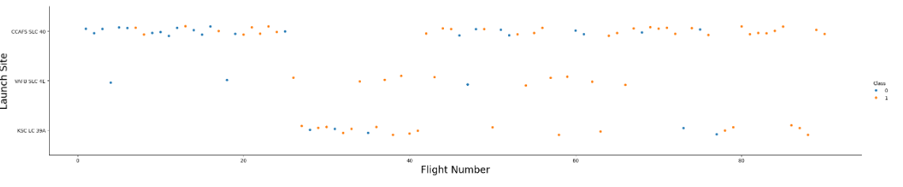
Flight Number vs. Launch Site
Scatterplot of Flight Number vs. Launch Site
Earlier flights had a lower success rate; later flights had a higher success rate
CCAFS SLC 40 launch site is about half of the launches
VAFB SLC 4E and KSC LC 39A have the highest success rates
We can assume the newer launches have a higher success rate

Slide 19
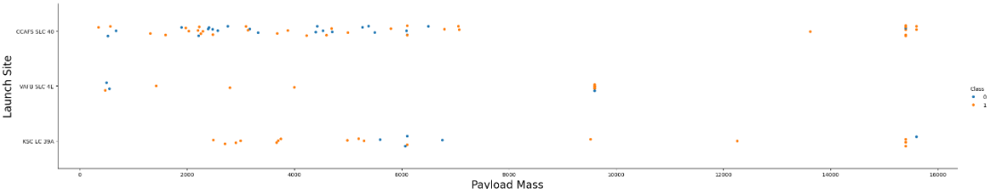
Payload vs. Launch Site
Scatterplot of Payload vs. Launch Site
The higher the Payload Mass, the higher the success rate
Most launches with a Payload Mass over 7000kg, were successful
KSC LC 39A has a 100% success rate for launches under 5000kg
VAFB SKC 4E has not launched anything greater than 10,000kg

Slide 20
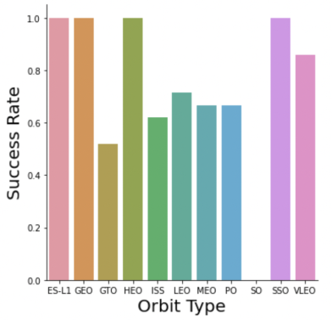
Success Rate vs. Orbit Type
Bar chart for the success rate of each orbit type
ES-L1, GEO, HEO, and SSO have a 100% success rate
GTO, ISS, LEO, MEO, and PO have a success rate between 50% and 85%
SO has 0% success rate

Slide 21
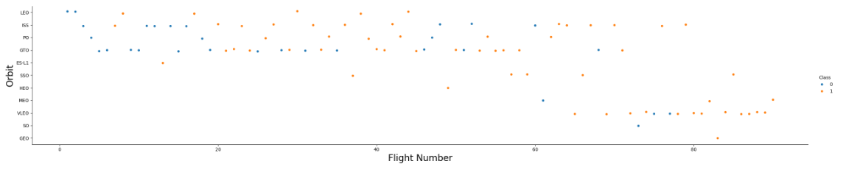
Flight Number vs. Orbit Type
Scatter plot of Flight number vs. Orbit type
LEO success rate increases with number of flights for each orbit
GTO orbit has no trend

Slide 22
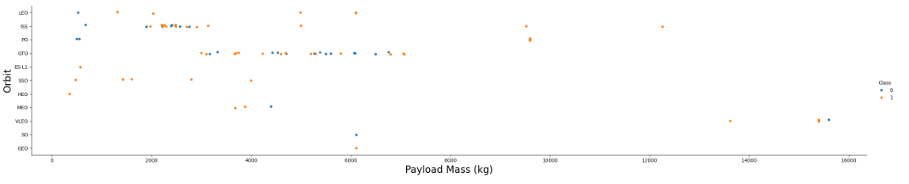
Payload vs. Orbit Type
Scatter plot of payload vs. orbit type
Heavier payloads perform better in LEO, ISS, and PO orbits
GTO orbits does not perform as well with heavier payloads

Slide 23
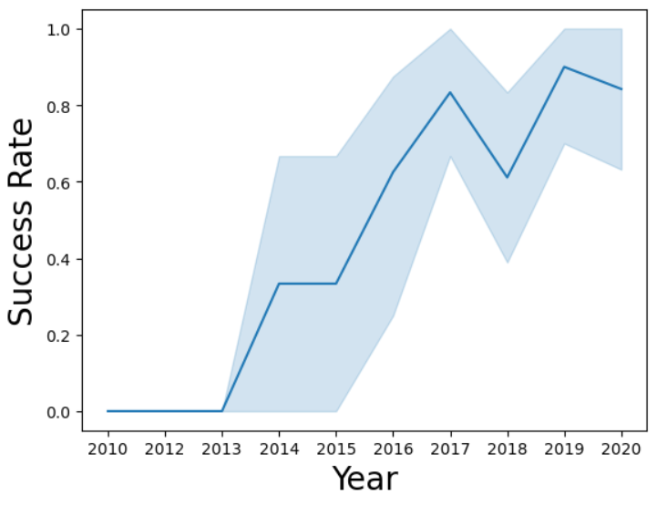
Launch Success Yearly Trend
Line chart of yearly average success rate
Success rate improved between 2013-2017 and 2018-2019
Success rate decreased from 2017-2018
Overall, success rate increased

Slide 24
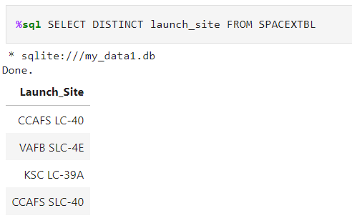
All Launch Site Names
Displaying the unique launch sites

Slide 25
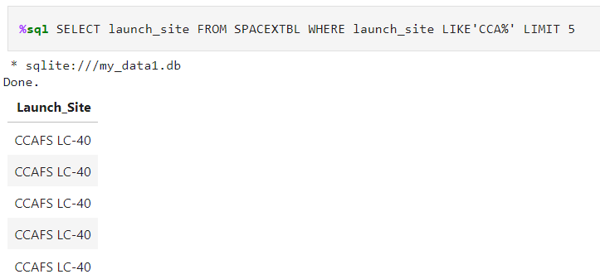
Launch Site Names Begin with 'CCA'
5 records where launch sites begin with `CCA’

Slide 26
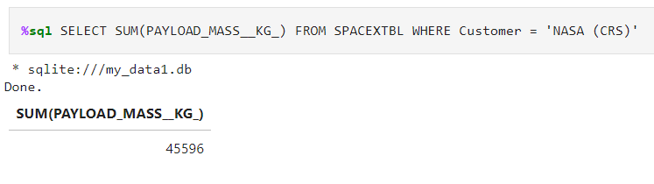
Total Payload Mass
Total payload carried by boosters from NASA (CRS

Slide 27
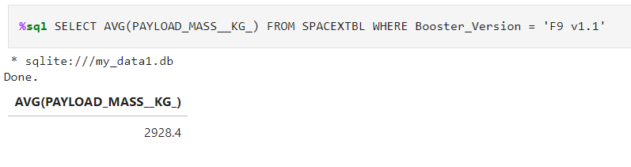
Average Payload Mass by F9 v1.1
Average payload mass carried by booster version F9 v1.1

Slide 28
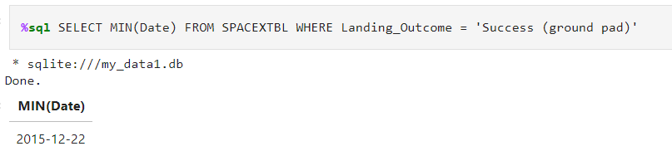
First Successful Ground Landing Date
Date of the first successful landing outcome on ground pad

Slide 29
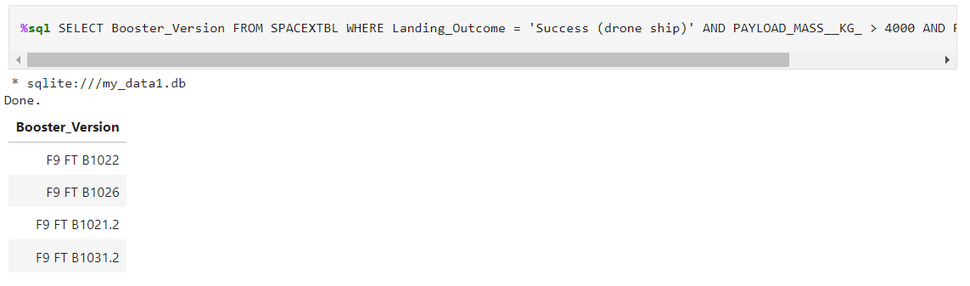
Successful Drone Ship Landing with Payload between 4000 and 6000
Names of boosters which have successfully landed on drone ship and had payload mass greater than 4000 but less than 6000

Slide 30
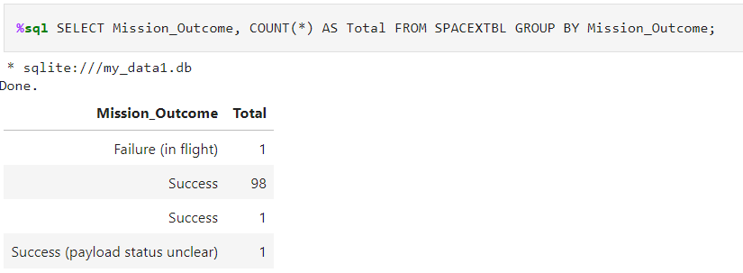
Total Number of Successful and Failure Mission Outcomes
Total number of successful and failure mission outcomes

Slide 31
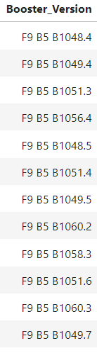
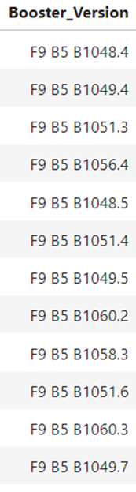
Boosters Carried Maximum Payload
Names of the booster which have carried the maximum payload mass

Slide 32
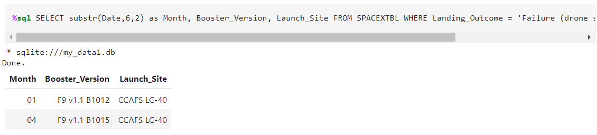
2015 Launch Records
Failed landing_outcomes in drone ship, their booster versions, and launch site names for in year 2015

Slide 33
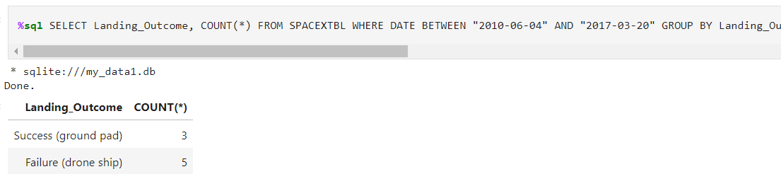
Rank Landing Outcomes Between 2010-06-04 and 2017-03-20
Ranking the count of landing outcomes (such as Failure (drone ship) or Success (ground pad)) between the date 2010-06-04 and 2017-03-20, in descending order

Slide 34

Section 3

Slide 35
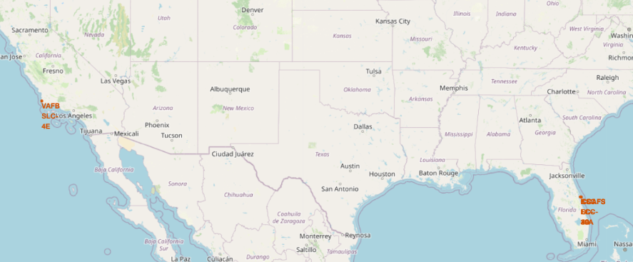
Launch Sites
Launch sites are closer to the equator as it is easier to launch closer to the equatorial orbit and using the earths rotation for the rockets orbit

Slide 36
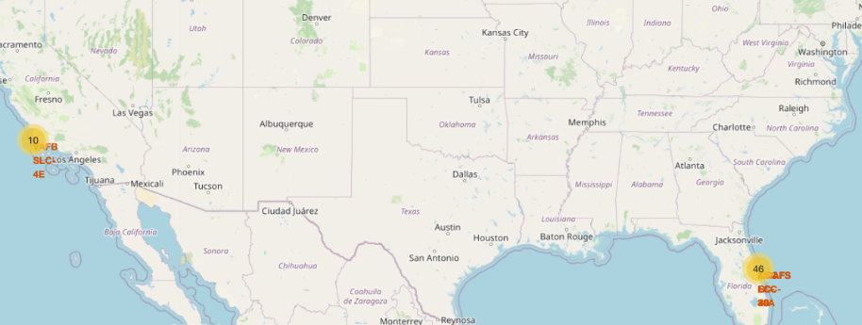
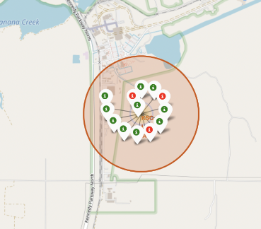
Colour Labelled Success Launch Site Markers
Green markers show successful outcomes
Red markers show unsuccessful outcomes
The launch site KSC LC-39A had a high level of successes

Slide 37
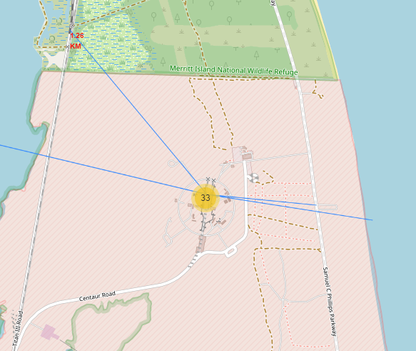
Distance to Proximities
The visual depicts that the launch site is relatively close to
Railways
For transport of resources
Highways
Transport
Coastlines
Ensures any dropped stages do not drop on people or infrastructure
Launch sites are further from cities to avoid damaging populated areas

Slide 38

Section 4

Slide 39
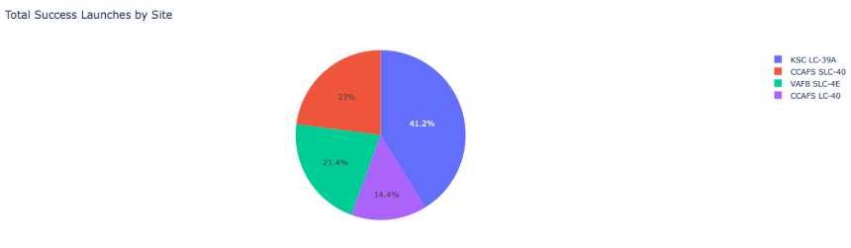
Launch Success by Site
Pie chart to show launch success by Site
KSC LC-39A has the most successful launches amongst all sites

Slide 40
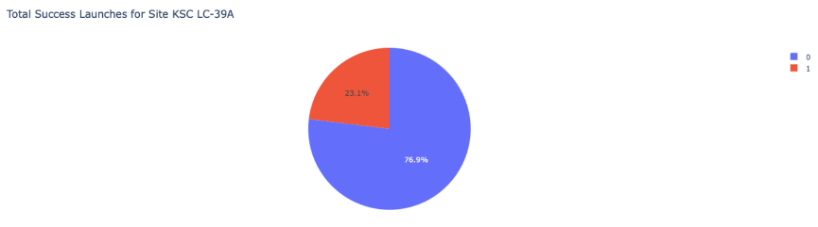
KSC LC-39A Launch Success
Pie chart to show the launch success of the site KSC LC-39A
76.9% of launches were a success, making this site the mlost successful launch site

Slide 41
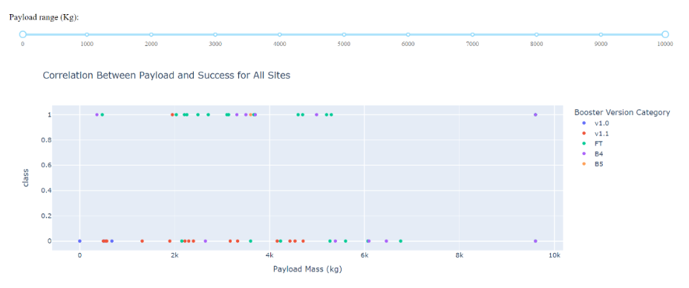
Payload Mass Vs Success
Scatter plot to show the correlation between Payload Mass and Success for all sites
Payloads between 2000kg and 5000kg have the highest success rates

Slide 42

Section 5

Slide 43
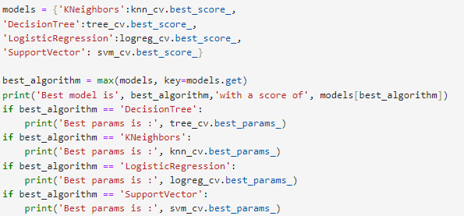
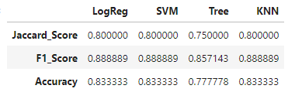
Classification Accuracy
All models perform at the same level with accuracy scores of 0.83
Likely due to a small data set
The decision tree performed the best

Slide 44

Confusion Matrix
Confusion matrix summarizes the performance of a classification algorithm
All confusion matrices were identical
12 True positives
3 True negatives
3 False positives
0 False negatives
The false positives are a major problem

Slide 45
Conclusions
Decision Tree is the best algorithm model for this data
Most launches are close to the equator and coastlines but further from cities
Launch success increases overtime, KSC LC-39A has the highest success rate of launches
The higher the payload mass the better the performance
Orbits ES-L1, GEO, HEO, and SSO have a 100% success rate

Slide 46


